Slide 1
Session 7:Process management

Slide 2
Process Concept
An operating system executes a variety of programs:
Batch system – jobs
Time-shared systems – user programs or tasks
Process – a program in execution; process execution must progress in sequential fashion
Multiple parts
The program code, also called text section
Current activity including program counter, processor registers
Stack containing temporary data
Function parameters, return addresses, local variables
Data section containing global variables
Heap containing memory dynamically allocated during run time
■

Slide 3
Process Concept
Program is passive entity stored on disk (executable file), process is active
Program becomes process when executable file loaded into memory
Execution of program started via GUI mouse clicks, command line entry of its name, etc
One program can be several processes
Consider multiple users executing the same program

Slide 4
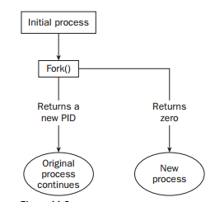
New process creation

Slide 5
Multiple Fork
Parent
{Fork()
statement
Fork()
Print(“hello”)}
Child-2
{Fork()
Fork()
Print(“hello”)}
Child -1
{Fork()
statement
Fork()
Print(“hello”)}
Child 1-1
{Fork()
Fork()
Print(“hello”)}

Slide 6
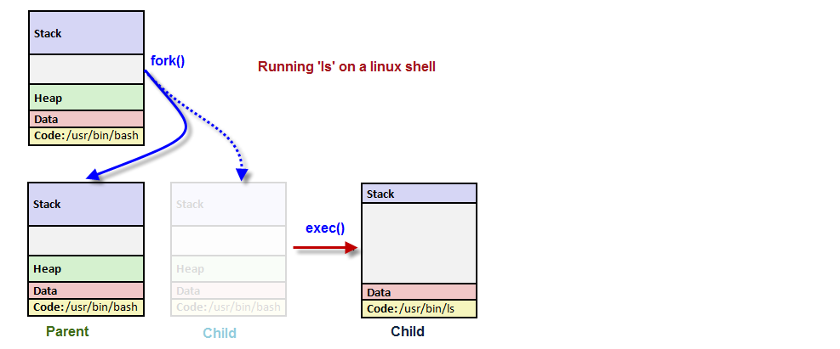
Fork and Exec system call

Slide 7
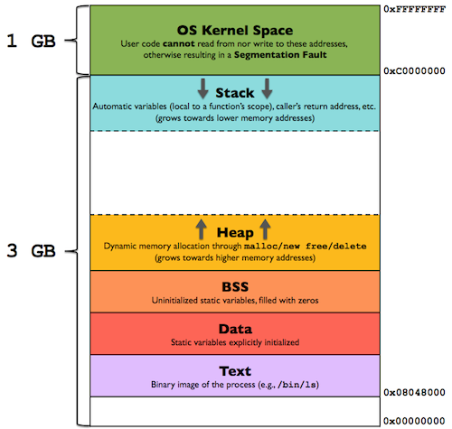
Process Address Segment

Slide 8
Process State
As a process executes, it changes state
new: The process is being created
running: Instructions are being executed
waiting: The process is waiting for some event to occur
ready: The process is waiting to be assigned to a processor
terminated: The process has finished execution

Slide 9
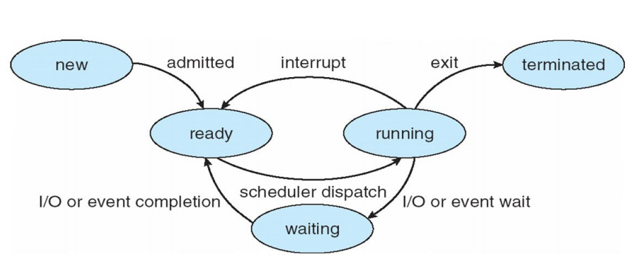
Diagram of Process State

Slide 10
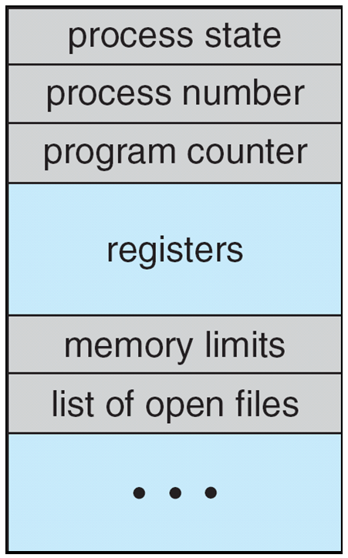
Process Control Block (PCB)
Information associated with each process
Process state
Program counter
CPU registers
CPU scheduling information
Memory-management information
Accounting information
I/O status information
$/proc/<process_id>

Slide 11
Parent and child process
Every process has a parent ID (ppid) along with its
own id (pid);
Majority of the processes have shell as their parent;
Parent of all the processes is “init”;
Zombie and Orphan Processes
Usually a child process gets terminated first;
When a child process gets killed, parent is informed with command “SIGCHLD”

Slide 12
Parent and child process
Sometimes when a parent process gets killed or terminated before the child process then “init” becomes the parent of the orphaned processes.
Processes that have completed their execution but are still present in the system and not dead are called as “zombie processes”. Such processes are displayed with z state in ps command.
Daemon Processes: System related background processes that run usually with root permission.

Slide 13
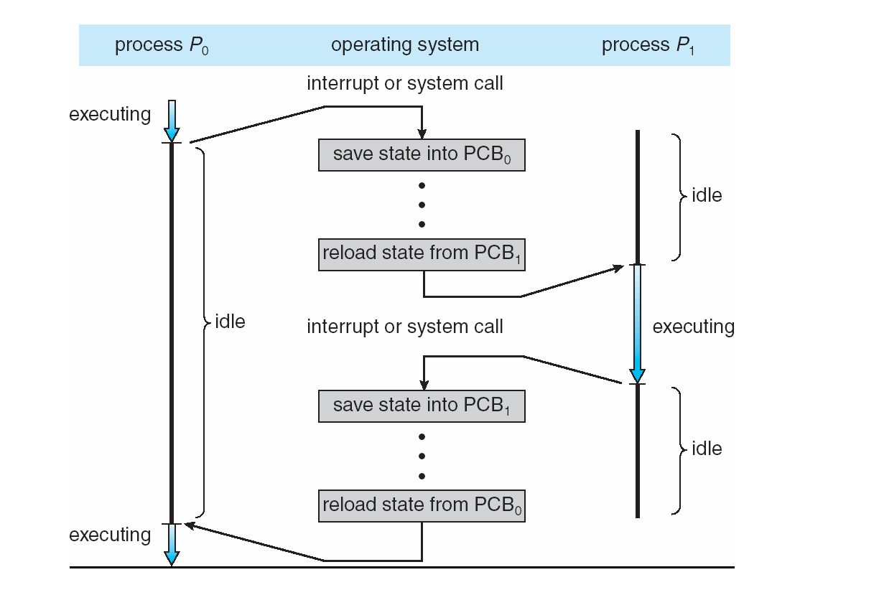
CPU Switch From Process to Process, thread

Slide 14
Process Scheduling Queues
Job queue – set of all processes in the system
Ready queue – set of all processes residing in main memory, ready and waiting to execute
Device queues – set of processes waiting for an I/O device
Processes migrate among the various queues

Slide 15
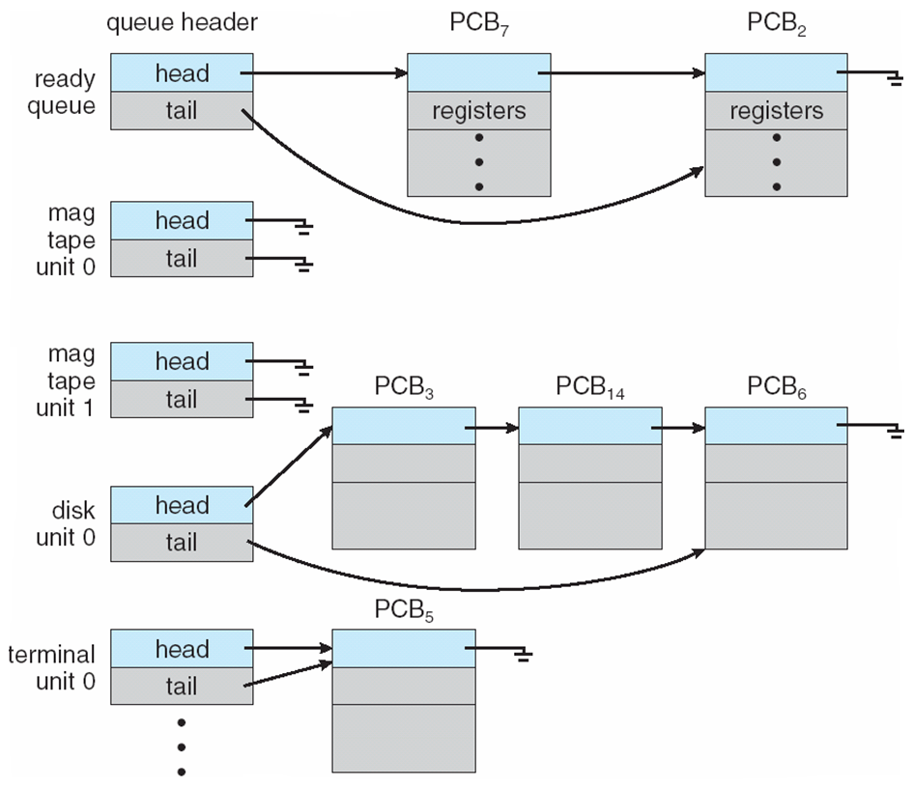
Ready Queue And Various I/O Device Queues

Slide 16
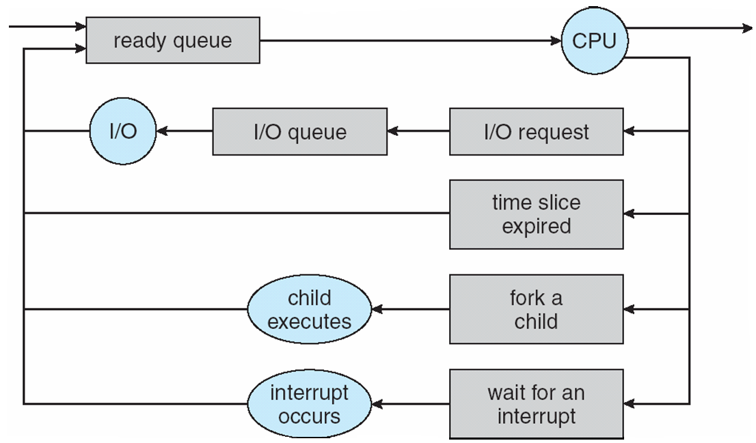
Representation of Process Scheduling

Slide 17
Schedulers
Long-term scheduler (or job scheduler) – selects which processes should be brought into the ready queue
Short-term scheduler (or CPU scheduler) – selects which process should be executed next and allocates CPU
Short-term scheduler is invoked very frequently (milliseconds) ⇒ (must be fast)
Long-term scheduler is invoked very infrequently (seconds, minutes) ⇒ (may be slow)
The long-term scheduler controls the degree of multiprogramming

Slide 18
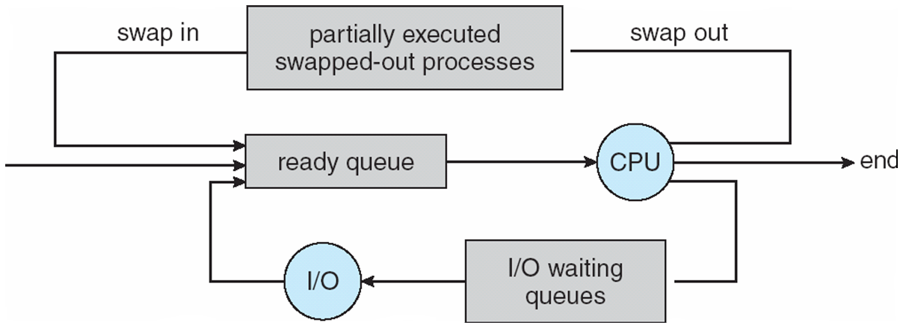
Medium-term scheduler
Medium-term scheduler can be added if degree of multiple programming needs to decrease
Remove process from memory, store on disk, bring back in from disk to continue execution: swapping

Slide 19
Scheduling
Processes can be described as either:
I/O-bound process – spends more time doing I/O than computations, many short CPU bursts
CPU-bound process – spends more time doing computations; few very long CPU bursts
Types of scheduling
Preemptive scheduling
Non preemptive scheduling

Slide 20
Context switch
When CPU switches to another process, the system must save the state of the old process and load the saved state for the new process via a context switch
Context of a process represented in the PCB
Context-switch time is overhead; the system does no useful work while switching
Time dependent on hardware support

Slide 21
CPU Scheduling
Maximum CPU utilization obtained with multiprogramming
CPU–I/O Burst Cycle – Process execution consists of a cycle of CPU execution and I/O wait
CPU burst followed by I/O burst
CPU burst distribution is of main concern

Slide 22
CPU Scheduler
Short-term scheduler selects from among the processes in ready queue, and allocates the CPU to one of them
Queue may be ordered in various ways
CPU scheduling decisions may take place when a process:
Switches from running to waiting state
Switches from running to ready state
Switches from waiting to ready
Terminates
Scheduling under 1 and 4 is nonpreemptive
All other scheduling is preemptive
Consider access to shared data
Consider preemption while in kernel mode
Consider interrupts occurring during crucial OS activities

Slide 23
Dispatcher
Dispatcher module gives control of the CPU to the process selected by the short-term scheduler; this involves:
switching context
switching to user mode
jumping to the proper location in the user program to restart that program
Dispatch latency – time it takes for the dispatcher to stop one process and start another running

Slide 24
Scheduling Criteria/parameter
CPU utilization – keep the CPU as busy as possible
Throughput – # of processes that complete their execution per time unit
Turnaround time – amount of time to execute a particular process
Waiting time – amount of time a process has been waiting in the ready queue
Response time – amount of time it takes from when a request was submitted until the first response is produced, not output (for time-sharing environment)

Slide 25
Scheduling Algorithms/policies
Basic scheduling algorithms
First-come First-served (FCFS)
Round Robin (RR)
Shortest Job First (SJF)
Priority based (PRIO)

Slide 26
First-come First-served (FCFS)
Process Burst Time
P₁ 24
P₂ 3
P₃ 3
Suppose that the processes arrive in the order: P₁ , P₂ , P₃ The Gantt Chart for the schedule is:
Waiting time for P₁ = 0; P₂ = 24; P₃ = 27
Average waiting time: (0 + 24 + 27)/3 = 17
P₁
P₂
P₃
0
24
27
30

Slide 27
FCFS Scheduling (Cont.)
Suppose that the processes arrive in the order:
P₂ , P₃ , P₁
The Gantt chart for the schedule is:
Waiting time for P₁ = 6; P₂ = 0; P₃ = 3
Average waiting time: (6 + 0 + 3)/3 = 3
Much better than previous case
Convoy effect - short process behind long process
Consider one CPU-bound and many I/O-bound processes
P₂
P₃
P₁
0
3
6
30

Slide 28
FCFS Scheduling (Cont.)
FCFS - First-Come, First-Served
Non-preemptive
Ready queue is a FIFO queue
Jobs arriving are placed at the end of queue
Dispatcher selects first job in queue and this job runs to completion of CPU burst
Advantages: simple, low overhead
Disadvantages: inappropriate for interactive systems, large fluctuations in average turnaround time are possible.

Slide 29
FCFS Scheduling (Cont.)
Workload (Batch system)
Job 1: 24 units, Job 2: 3 units, Job 3: 3 units
FCFS schedule:
| Job 1 | Job 2 | Job 3 | 0 24 27 30
Total waiting time:
Average waiting time:
Total turnaround time:
Average turnaround time:
0 + 24 + 27 = 51
51/3 = 17
24 + 27 + 30 = 81
81/3 = 27

Slide 30
Shortest Job First (SJF)
Associate with each process the length of its next CPU burst
Use these lengths to schedule the process with the shortest time
SJF is optimal – gives minimum average waiting time for a given set of processes
The difficulty is knowing the length of the next CPU request
Could ask the user

Slide 31
Example of SJF
ProcessArriva l Time Burst Time
P₁ 0.0 6
P₂ 2.0 8
P₃ 4.0 7
P₄ 5.0 3
SJF scheduling chart
Average waiting time = (3 + 16 + 9 + 0) / 4 = 7
P₄
P₁
P₃
P₂
0
3
9
16
24

Slide 32
Example of Shortest-remaining-time-first
Now we add the concepts of varying arrival times and preemption to the analysis
Process Arrival TimeT Burst Time
P1 0 8
P2 1 4
P3 2 9
P4 3 5
Preemptive SJF Gantt Chart
Average waiting time = [(10-1)+(1-1)+(17-2)+5-3)]/4 = 26/4 = 6.5 msec
P₁
P₂
P₄
P₁
P₃
0
1
5
10
17
26

Slide 33
Shortest Job First (SJF)
Non-preemptive, SJF-preemptive is SRJF
Ready queue treated as a priority queue based on smallest CPU-time requirement
arriving jobs inserted at proper position in queue
dispatcher selects shortest job (1st in queue) and runs to completion
Advantages: provably optimal w.r.t. average turnaround time
Disadvantages: in general, cannot be implemented. Also, starvation possible !
Can do it approximately: use exponential averaging to predict length of next CPU burst ==> pick shortest predicted burst next!

Slide 34
Priority Scheduling
A priority number (integer) is associated with each process
The CPU is allocated to the process with the highest priority (smallest integer ≡ highest priority)
Preemptive
Nonpreemptive
SJF is priority scheduling where priority is the inverse of predicted next CPU burst time
Problem ≡ Starvation – low priority processes may never execute
Solution ≡ Aging – as time progresses increase the priority of the process

Slide 35
Example of Priority Scheduling
ProcessA arri Burst TimeT Priority
P₁ 10 3
P₂ 1 1
P₃ 2 4
P₄ 1 5
P₅ 5 2
Priority scheduling Gantt Chart
Average waiting time = 8.2 msec
P₂
P₅
P₁
P₃
P₄
0
1
6
16
18
19

Slide 36
Round Robin (RR)
Each process gets a small unit of CPU time (time quantum q), usually 10-100 milliseconds. After this time has elapsed, the process is preempted and added to the end of the ready queue.
If there are n processes in the ready queue and the time quantum is q, then each process gets 1/n of the CPU time in chunks of at most q time units at once. No process waits more than (n-1)q time units.
Timer interrupts every quantum to schedule next process

Slide 37
Example of RR with Time Quantum = 4
Process Burst Time
P₁ 24
P₂ 3
P₃ 3
The Gantt chart is:
Typically, higher average turnaround than SJF, but better response
q should be large compared to context switch time
q usually 10ms to 100ms, context switch < 10 usec
P₁
P₂
P₃
P₁
P₁
P₁
P₁
P₁
0
4
7
10
14
18
22
26
30

Slide 38
Multilevel Queue
Ready queue is partitioned into separate queues, eg:
foreground (interactive)
background (batch)
Process permanently in a given queue
Each queue has its own scheduling algorithm:
foreground – RR
background – FCFS
Scheduling must be done between the queues:
Fixed priority scheduling; (i.e., serve all from foreground then from background). Possibility of starvation.
Time slice – each queue gets a certain amount of CPU time which it can schedule amongst its processes; i.e., 80% to foreground in RR
20% to background in FCFS

Slide 39
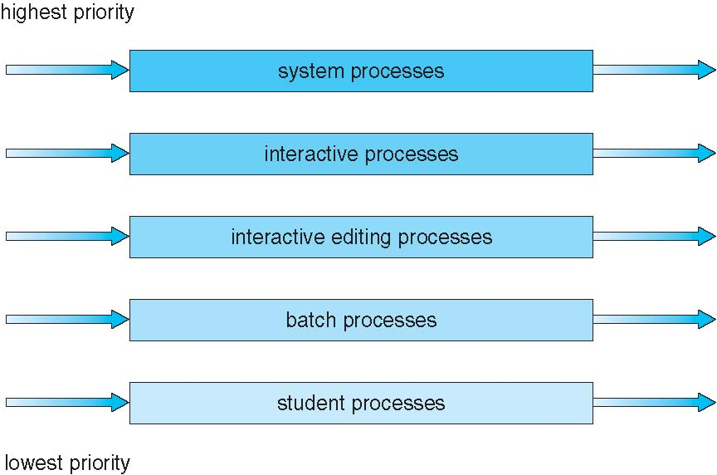
Multilevel Queue Scheduling

Slide 40
Multicore Processors
Recent trend to place multiple processor cores on same physical chip
Faster and consumes less power
Multiple threads per core also growing
Takes advantage of memory stall to make progress on another thread while memory retrieve happens

Slide 41
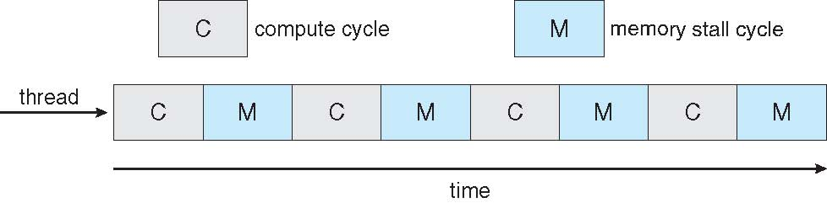

Multithreaded Multicore System

Slide 42
Thread
Most modern applications are multithreaded
Threads run within application
Multiple tasks with the application can be implemented by separate threads
Update display
Fetch data
Spell checking
Answer a network request
Process creation is heavy-weight while thread creation is light-weight
Can increase efficiency
Kernels are generally multithreaded

Slide 43
Multithreaded Server Architecture

Slide 44
Benefits
Responsiveness – may allow continued execution if part of process is blocked, especially important for user interfaces
Resource Sharing – threads share resources of process, easier than shared memory or message passing
Economy – cheaper than process creation, thread switching lower overhead than context switching
Scalability – process can take advantage of multiprocessor architectures

Slide 45
Multicore Programming
Multicore or multiprocessor systems putting pressure on programmers.
Concurrent execution on single-core system:
Parallelism on a multi-core system:

Slide 46
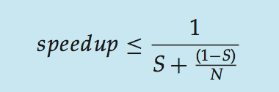
Amdahl’s Law
Identifies performance gains from adding additional cores to an application that has both serial and parallel components
S is serial portion
N processing cores
I.e. if application is 75% parallel / 25% serial, moving from 1 to 2 cores results in speedup of 1.6 times
As N approaches infinity, speedup approaches 1 / S
Serial portion of an application has disproportionate effect on performance gained by adding additional cores
But does the law take into account contemporary multicore systems?

Slide 47
Single and Multithreaded Processes

Slide 48
User Threads and Kernel Threads
User threads - management done by user-level threads library
Kernel threads - Supported by the Kernel

Slide 49
Multithreading Models
Many-to-One
One-to-One
Many-to-Many

Slide 50
Many-to-One
Many user-level threads mapped to single kernel thread
One thread blocking causes all to block
Multiple threads may not run in parallel on muticore system because only one may be in kernel at a time
Few systems currently use this model
Examples:
Solaris Green Threads
GNU Portable Threads

Slide 51
One to One
Each user-level thread maps to kernel thread
Creating a user-level thread creates a kernel thread
More concurrency than many-to-one
Number of threads per process sometimes restricted due to overhead
Examples
Windows
Linux
Solaris 9 and later

Slide 52
Many-to-Many Model
Allows many user level threads to be mapped to many kernel threads
Allows the operating system to create a sufficient number of kernel threads
Solaris prior to version 9
Windows with the ThreadFiber package

